Slide 1
10th Grade Algebra
-Polynomials
Ms. Milner

Slide 2
After this Power Point you will be able to…
Simplify monomials and monomial expressions using the laws of integral exponents.
Add, subtract, and multiply polynomials.
Factor polynomial expressions.

Slide 3

What Are Polynomials?
- Polynomial comes from poly- (meaning “many”) and nomial (in this case meaning “term”)… so it says “many terms”
- A Polynomial is made up of terms that are only added, subtracted or multiplied.

Slide 4
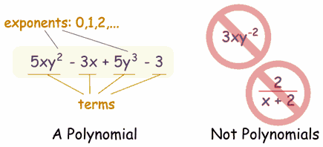
Simplifying Monomials!
To simplify monomials you must simply add or subtract like terms. Such as the x and the y terms.
Example: Take 3x +3 -2x +4 to simplify this function all you need to do is add the like terms…
3x +3-2x+4
x+3+4=x+7
Don’t forget PEMDAS (Please excuse my dear aunt sally) Parentheses, exponents, multiplication, division, addition, and subtraction.

Slide 5
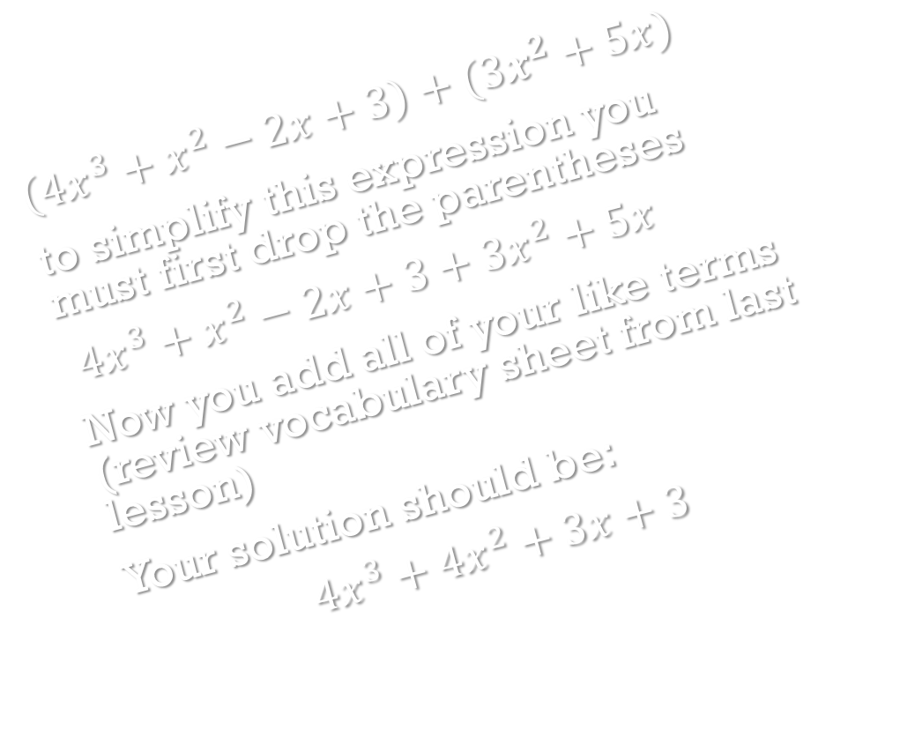
Adding Polynomials!
$\left(4x^{3}+x^{2}−2x+3\right)+(3x^{2}+5x)$
to simplify this expression you must first drop the parentheses
$4x^{3}+x^{2}−2x+3+3x^{2}+5x$
Now you add all of your like terms (review vocabulary sheet from last lesson)
Your solution should be:
$$4x^{3}+4x^{2}+3x+3$$
Note: In math usually the term with the highest degree (Vocabulary sheet?) goes in front of the equation.

Slide 6
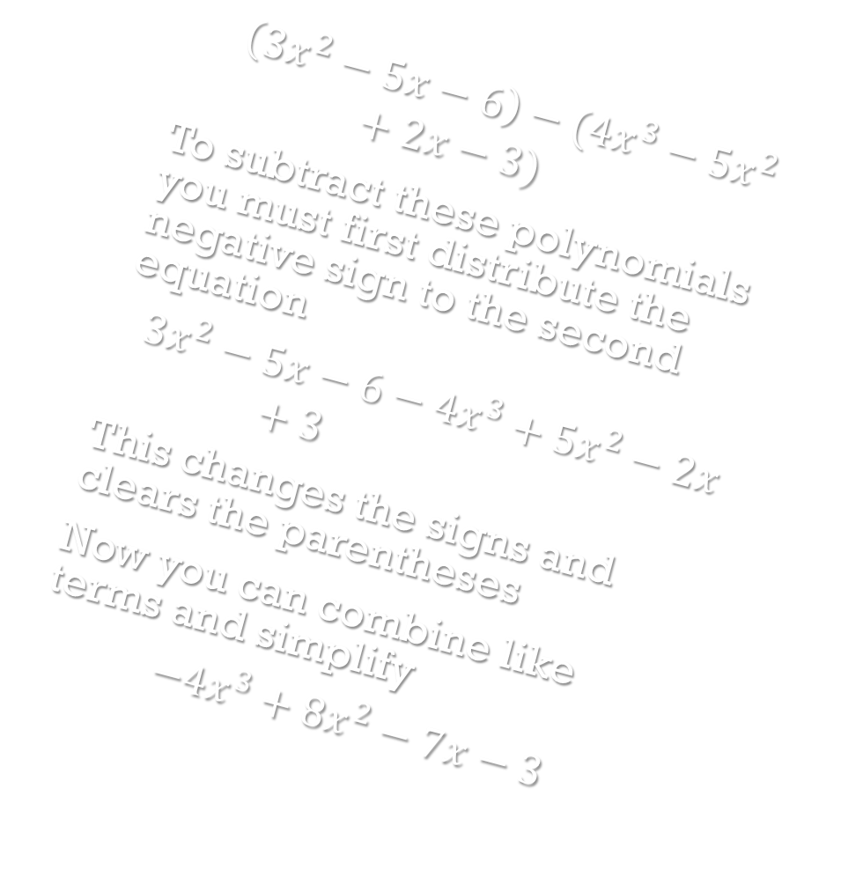
Subtracting polynomials!
$$\left(3x^{2}−5x−6\right)−(4x^{3}−5x^{2}+2x−3)$$
To subtract these polynomials you must first distribute the negative sign to the second equation
$$3x^{2}−5x−6−4x^{3}+5x^{2}−2x+3$$
This changes the signs and clears the parentheses
Now you can combine like terms and simplify
$$−4x^{3}+8x^{2}−7x−3$$

Slide 7


Multiplying Polynomials!
$$\left(3x+5\right)\left(3x−4\right)$$
To solve this we use a method called FOIL (first, inner, outer, and last)
$$\left(3x\right)\left(3x\right)+\left(3x\right)\left(−4\right)+\left(5\right)\left(3x\right)+\left(5\right)\left(−4\right)$$
This gives us:
$$9x^{2}−12x+15x−20$$
Which when we combine like terms gives us the solution
$$9x^{2}+3x−20$$
Reminder: When multiplying terms with exponents you add the exponents. When dividing terms with exponents you subtract the exponents.

Slide 8
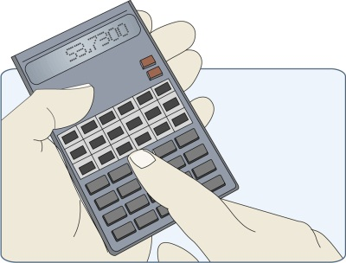


Take 10 min to simplify the following equations.
$\left(3x^{2}+x −2\right)+\left(x^{4}+2x^{3}−x^{2}+5\right)$
$\left(5x+7\right)−\left(−3x^{3}+4x+3\right)$
$\left(x^{5}+5x^{3}−3x^{2}+4x−1\right)−\left(2x^{4}−5x^{3}−x^{2}−4x−1\right)$
${(x+2)}^{2}$
$\left(x+5\right)\left(x−2\right)\left(x+1\right)$
Numbers 4 and 5 might be tricky, but remember all of the rules we have discussed in previous lessons and apply them here.

Slide 9






Answers!
1. $x^{4}+2x^{3}+2x^{2}+x+3$
2. $3x^{3}+x+4$
3. $x^{5}−2x^{4}+10x^{3}−2x^{2}+8x$
4. $x^{2}+4x+4$
5. $x^{3}+4x^{2}−7x−10$
So how did you do? Did those last two questions confuse you? Lets try them.

Slide 10



Solve It!
${(x+2)}^{2}$ This equals $(x+2)(x+2)$
Now we can solve by using our FOIL method.
Remember: First Inner Outer Last
$$\left(x\right)\left(x\right)+\left(2\right)\left(x\right)+\left(2\right)\left(x\right)+\left(2\right)\left(2\right)$$
$$=x^{2}+2x+2x+4$$
Now we can simplify!
$$x^{2}+4x+4$$

Slide 11




Solve It!
Now for the last problem:
$$\left(x+5\right)\left(x−2\right)\left(x+1\right)$$
To solve this we start with the first two equations in parentheses and FOIL
$$\left[\left(x\right)\left(x\right)+\left(−2\right)\left(x\right)+\left(5\right)\left(x\right)+\left(5\right)\left(−2\right)\right]\left(x+1\right)$$
$$=[x^{2}−2x+5x−10](x+1)$$
Now combine like terms:
$$=(x^{2}+3x−10)(x+1)$$
Now we can solve by using our FOIL method on the last part of the problem.
$$\left(x^{2}\right)\left(x\right)+x^{2}+\left(3x\right)\left(x\right)+3x+\left(−10\right)\left(x\right)−10$$
$$=x^{3}+x^{2}+3x^{2}+3x−10x−10$$
Combine like terms:
$$=x^{3}+4x^{2}−7x−10$$

Slide 12

Factoring Polynomials
Factoring is simplifying, just backwards. Instead of using the FOIL method to simplify an expression, we are going to try and do the opposite.
We will stick to simple factoring in this lesson. In the following lesson we will learn even more factoring.

Slide 13
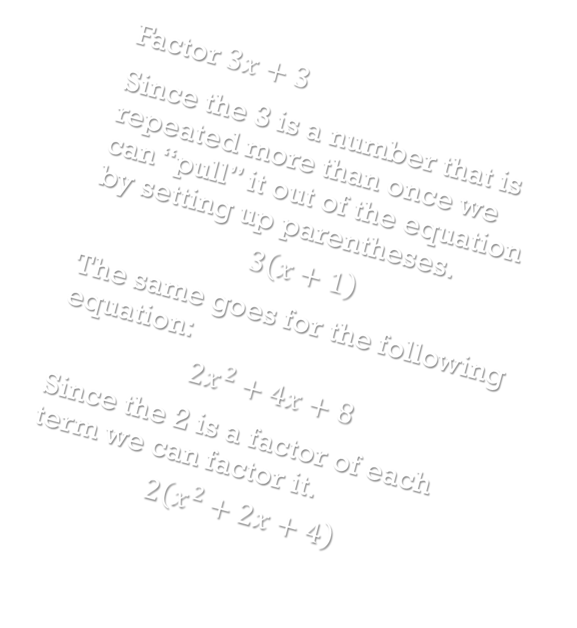
Examples
Factor $3x+3$
Since the 3 is a number that is repeated more than once we can “pull” it out of the equation by setting up parentheses.
$$3\left(x+1\right)$$
The same goes for the following equation:
$$2x^{2}+4x+8$$
Since the 2 is a factor of each term we can factor it.
$$2\left(x^{2}+2x+4\right)$$

Slide 14
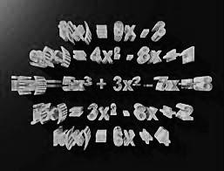
Group Time!
In individual groups of three factor completely the following equations.

Slide 15


$12x+24$
$4x+8y+16$
$−7xy−14y$
$5xyz+10xy+15x$
$50x+25z+25y$
$6x+3$
$8xy−4x^{2}$
$x^{2}+x$
$xyz+2xy$
$30x−20y$

Slide 16



Check Your Work
$12x+24=12(x+2)$
$4x+8y+16=4(x+2y+4)$
$−7xy−14y=−7y(x+2)$
$5xyz+10xy+15x=5x(yz+2y+3)$
$50x+25z+25y=25(2x+z+y)$
$6x+3=3(2x+1)$
$8xy−4x^{2}=4x(2y−x)$
$x^{2}+x=x(x+1)$
$xyz+2xy=xy(z+2)$
$30x−20y=10(3x−2y)$

Slide 17
Take a Look at These!
http://www.purplemath.com/
http://www.mathsisfun.com/
http://www.webmath.com/
http://www.slidermath.com/rpoly/Polym4.shtml
Above is a list of websites that have fun and interesting ways to study and learn polynomials and other subjects.

Slide 18
Don’t Forget Your Homework
Research Done:
http://homepage.mac.com/shelleywalsh/MathArt/Polynomial.html
http://www.mathsisfun.com/algebra/polynomials.html

